Slide 1
Lecture 11 Time Complexity and P
Time complexity,
complexity relations among models
the class P

Slide 2
Decision procedures: a summary
Most of problems about TMs are undecidable (Rice’s Theorem).
Almost all problems about DFAs are decidable.
However, for PDAs, there is a asymmetric balance between decidability and undecidability.

Slide 3
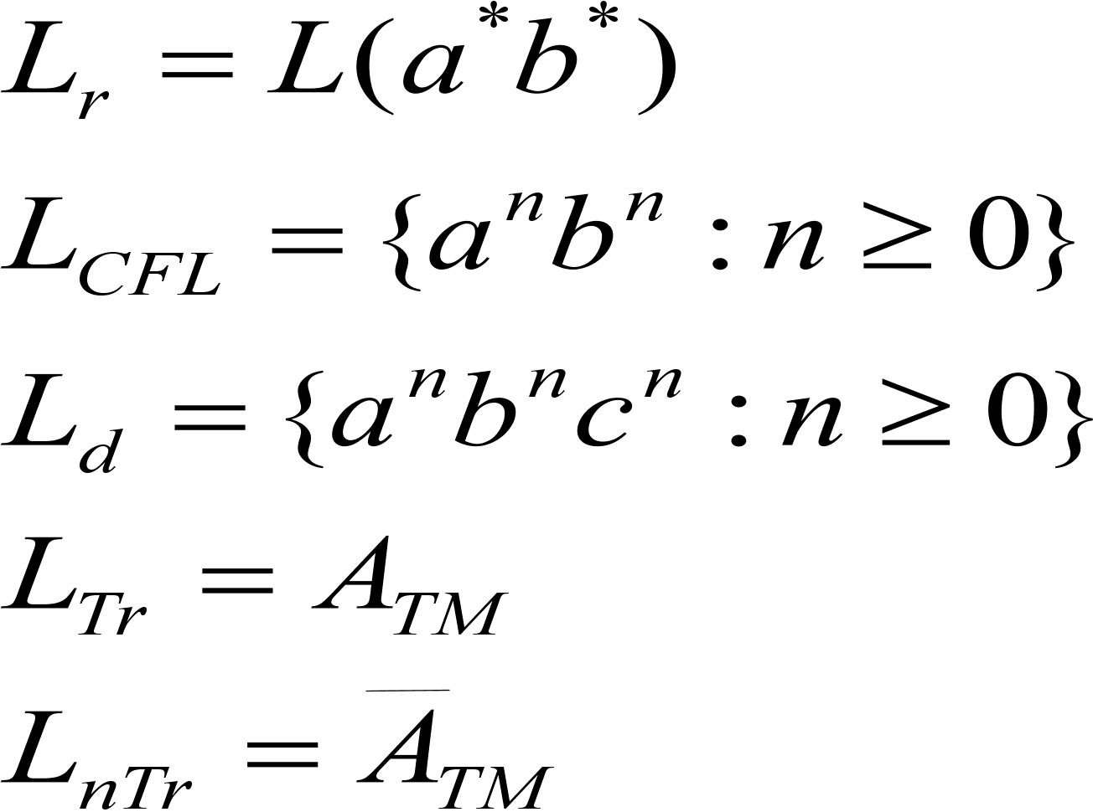
Where are we now?
Regular CFL
Regular CFL decidable Turing-recognizable
(Intuitive algorithm)
two lines in computability theory

Slide 4


Classical Theory
Algorithm
Decidability
Efficiency (P vs. NP)
decidable
inefficient
efficient

Slide 5
Efficient algorithms
PCP
A_{TM}
The running time of an algorithm depends on the input
For longer inputs, we allow more time
Efficiency is measured as a function of input size
decidable
EQPDA
inefficient
HALTTM
brute-force search
efficient

Slide 6
Input representation
Since we measure efficiency in terms of input size, how the input is represented will make a difference. Familiar encoding methods for graphs, automata, and the like are all reasonable.
The number 17
17
OK
10001
(17 in binary)
OK
11111111111111111
NO
1
2
Encoding as a list of nodes and edges
3
4
Adjacency matrix
This graph
The size of the encoding is polynomial in the number of nodes

Slide 7
Time complexity
Let M be a deterministic TM that halts on all inputs. The running time or time complexity of M is the function f: N ->N, where f(n) is the maximum number of steps that M uses on any input of length n. If f(n) is the running time of M, we say that M runs in time f(n) or M is an f(n)-time TM.
Worst-case analysis

Slide 8
Simulation of TM
q
δ(q, 0) = (q, 0, R)
δ(q, 1) = (f, 0, R)
δ(q, B) = (q, 1, L)
0 0 B B . . .

Slide 9
Simulation of TM
q
δ(q, 0) = (q, 0, R)
δ(q, 1) = (f, 0, R)
δ(q, B) = (q, 1, L)
0 0 1 B . . .

Slide 10
Simulation of TM
q
δ(q, 0) = (q, 0, R)
δ(q, 1) = (f, 0, R)
δ(q, B) = (q, 1, L)
0 0 1 B . . .

Slide 11
Configuration
q
Start configuration
Accepting configuration
Rejecting configuration
Halting Configuration
00q1B
0 0 1 B . . .

Slide 12
Computation path
For input w of length n,,
C0
C1
f(n)=max{l(w):w is an input of length n}
C2
Worst case
…
Cl(w)

Slide 13
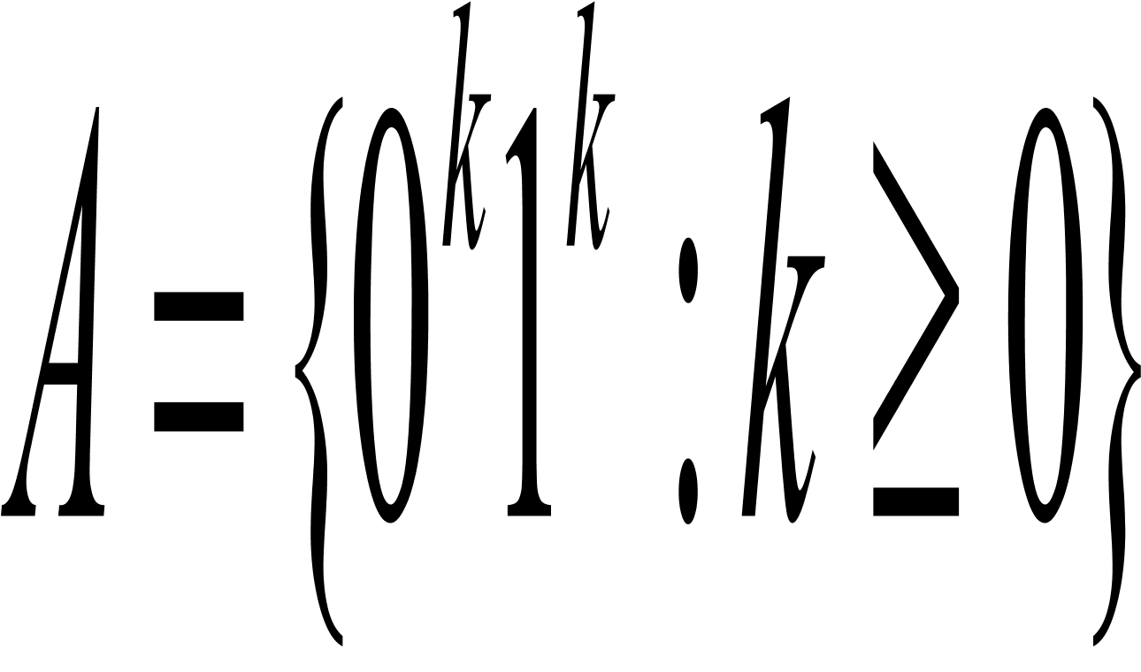
Algorithm analysis
Let
M1=“On input string w of length n:
1.Scan across the tape and reject if a 0 is found to the right of a 1.
2.Repeat the following if both 0s and 1s remain on the tape.
3. Scan across the tape, crossing a single 0 and a single 1.
4.If 0s still remain after all the 1s have been crossed off, or if 1s still remain after all the 0s have been crossed off, reject. O.W., if neither 0s nor 1s remain on the tape, accept.”
What is the worst case?

Slide 14
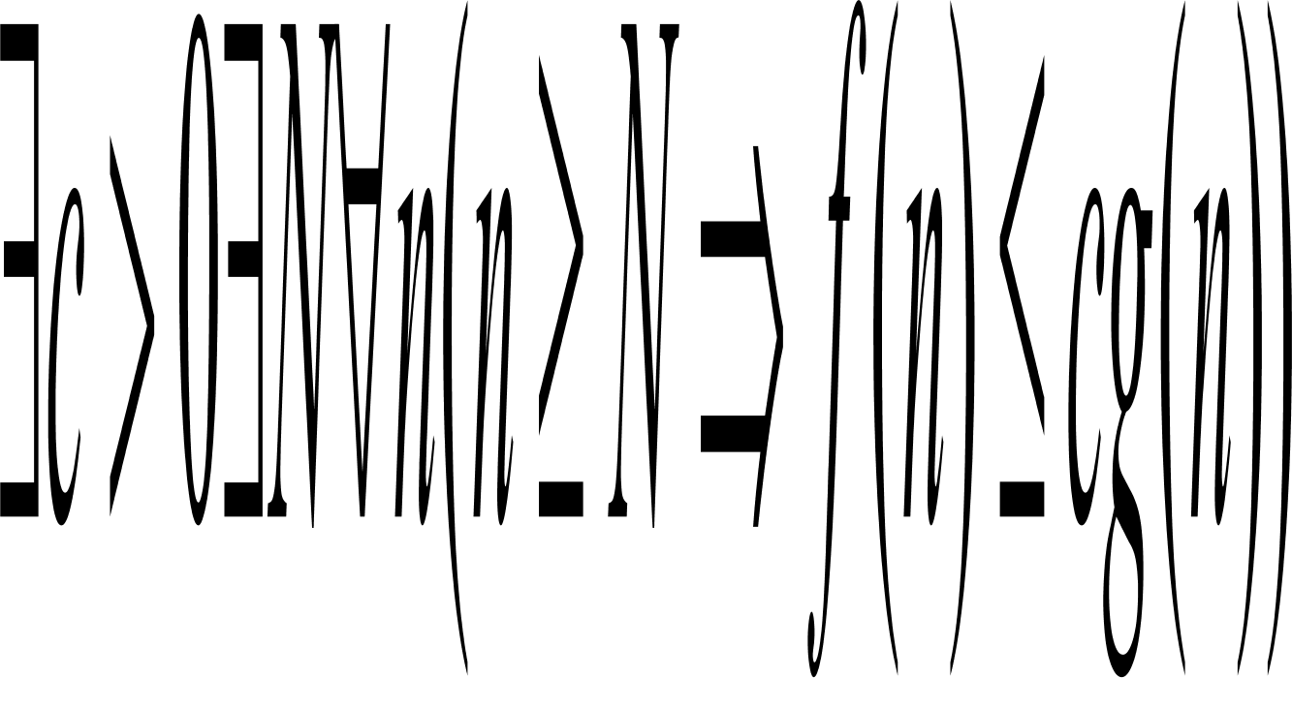
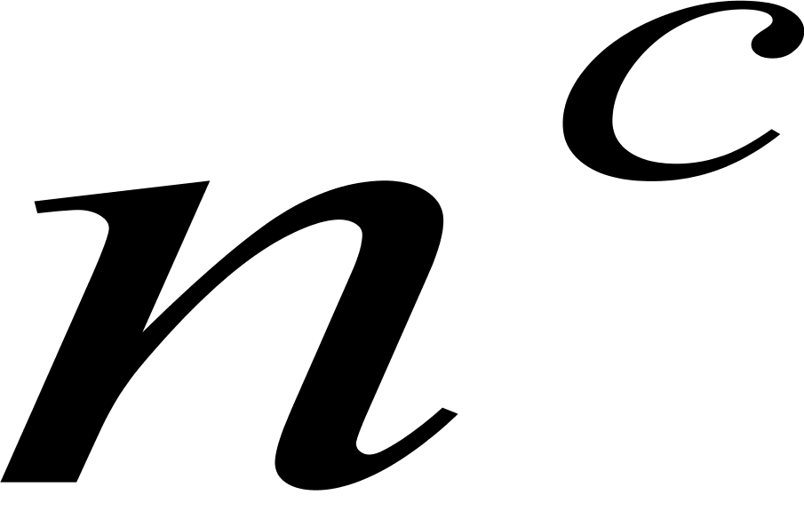
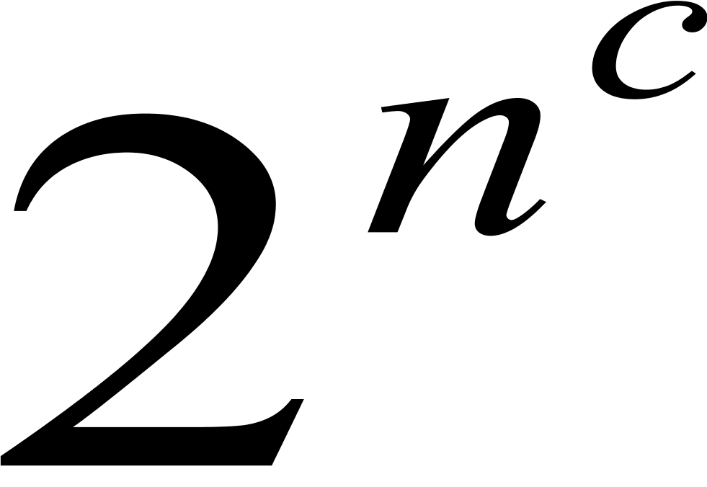
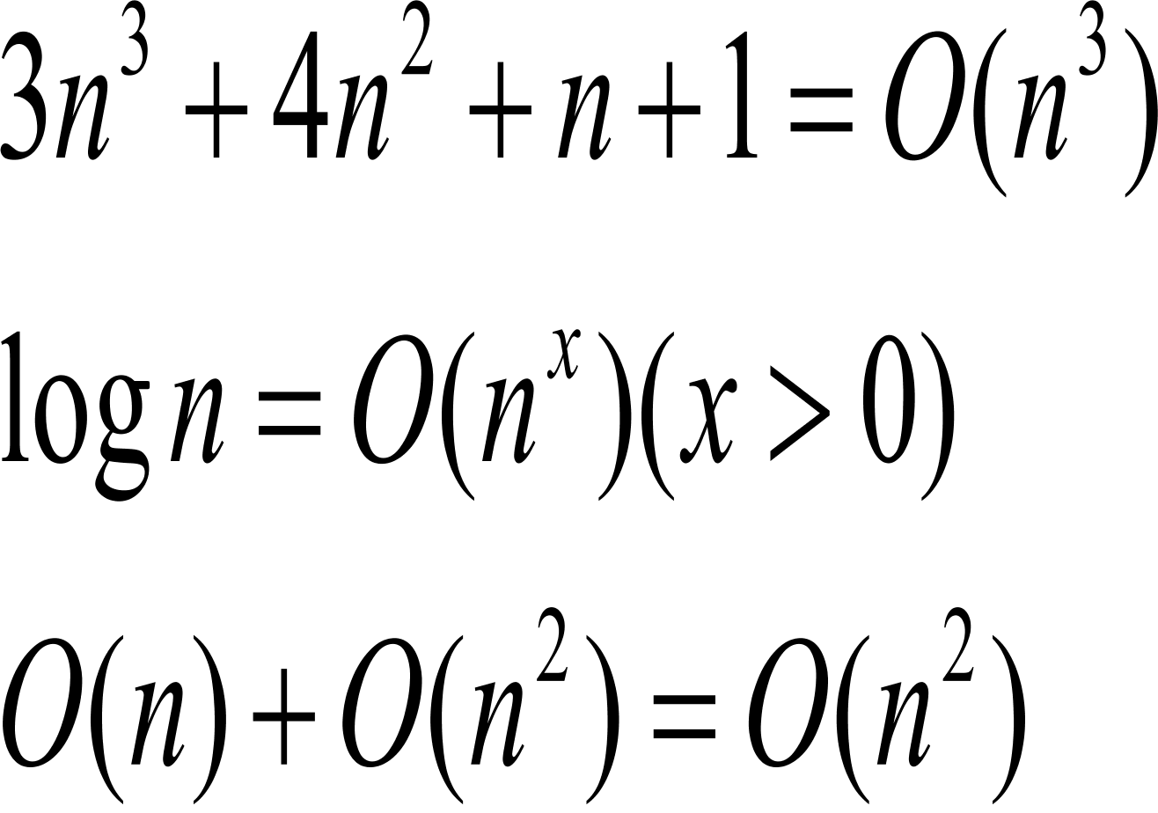
Big-O notation
g(n) is an asymptotic upper bound or simply upper bound for f(n) if
which is denoted f(n)=O(g(n)).
Polynomial bound:
Exponential bound:
For example:
Disregarding both the coefficients
and any lower order terms

Slide 15
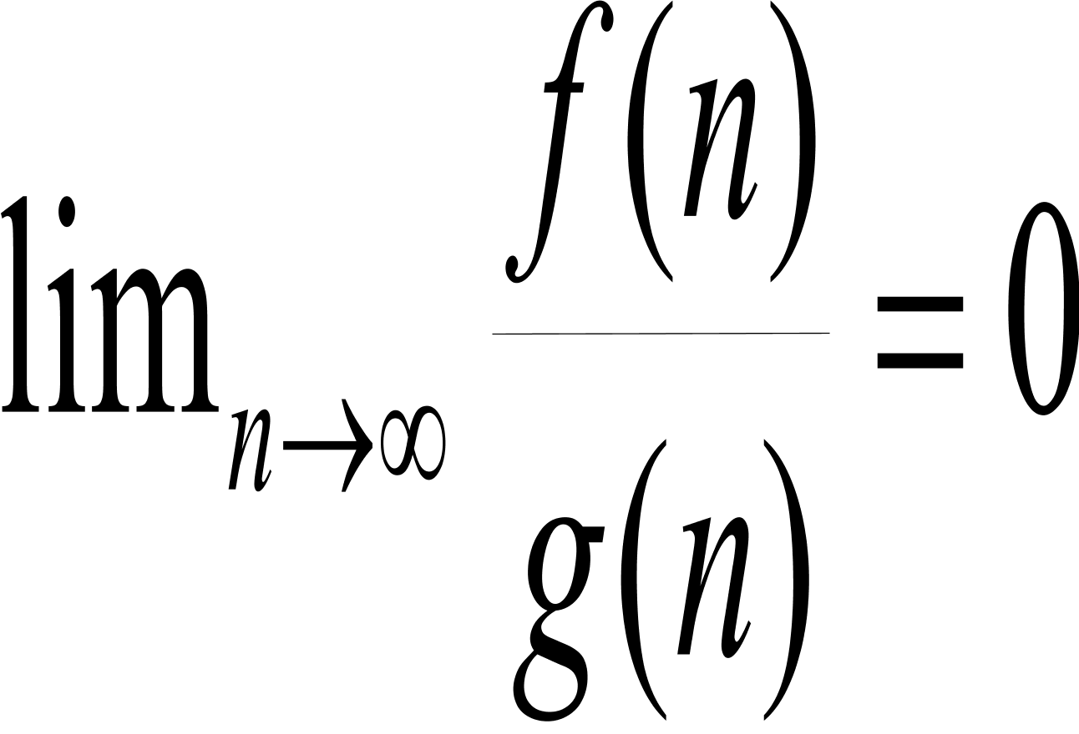
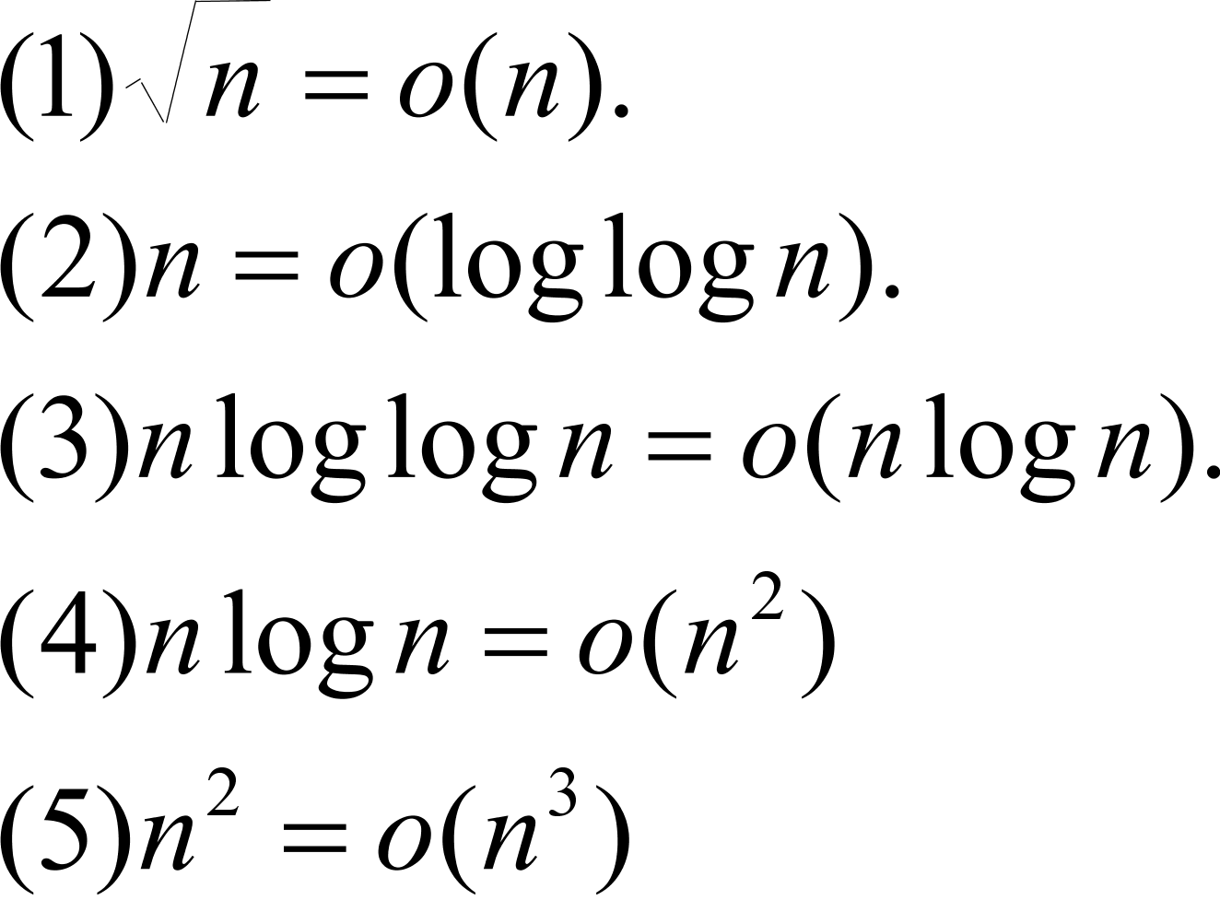
Small-O notation
f(n)=o(g(n)) if
For example:

Slide 16
A faster algorithm
M2=“On input w:
1. Scan across the tape and reject if a 0 is found to the right of a 1.
2. Repeat the following as long as some 0s and some 1s remain on the tape.
3. Scan across the tape, checking whether the total number of 0s and 1s remaining is even or odd. If it is odd, reject.
4. Scan across the tape, crossing off every other 0 starting with the first 0, and then crossing off every other 1 starting with the first 1.
5. If no 0s and no 1s remain on the tape, accept. Otherwise, reject. ”
In fact, this is the most Efficient algorithm. Any language that can be decided in o(nlogn) on a single-tape TM is regular.

Slide 17
Time complexity on a 2-tape TM
M3 is a 2-tape TM.
M3=“On input w:
1. Scan across the tape and reject if a 0 is found to the right of a 1.
2. Scan across the 0s and tape 1 until the first 1. At the same time, copy the 0s onto Tape 2.
3. Scan across the 1s on Tape 1 until the end of the input. For each 1 read on Tape 1, cross off a 0 on Tape 2. If all 0s are crossed off before all the 1s are read, reject.
4. If all the 0s now have been crossed off, accept. If any 0s remain, reject.”
Analyze its correctness and complexity

Slide 18
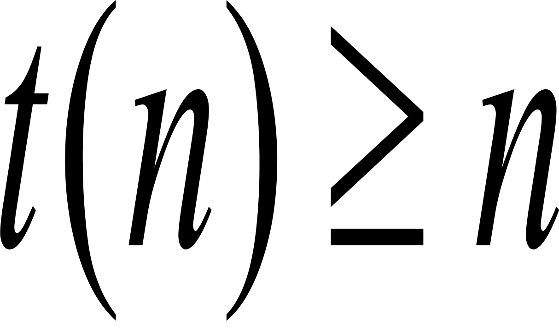
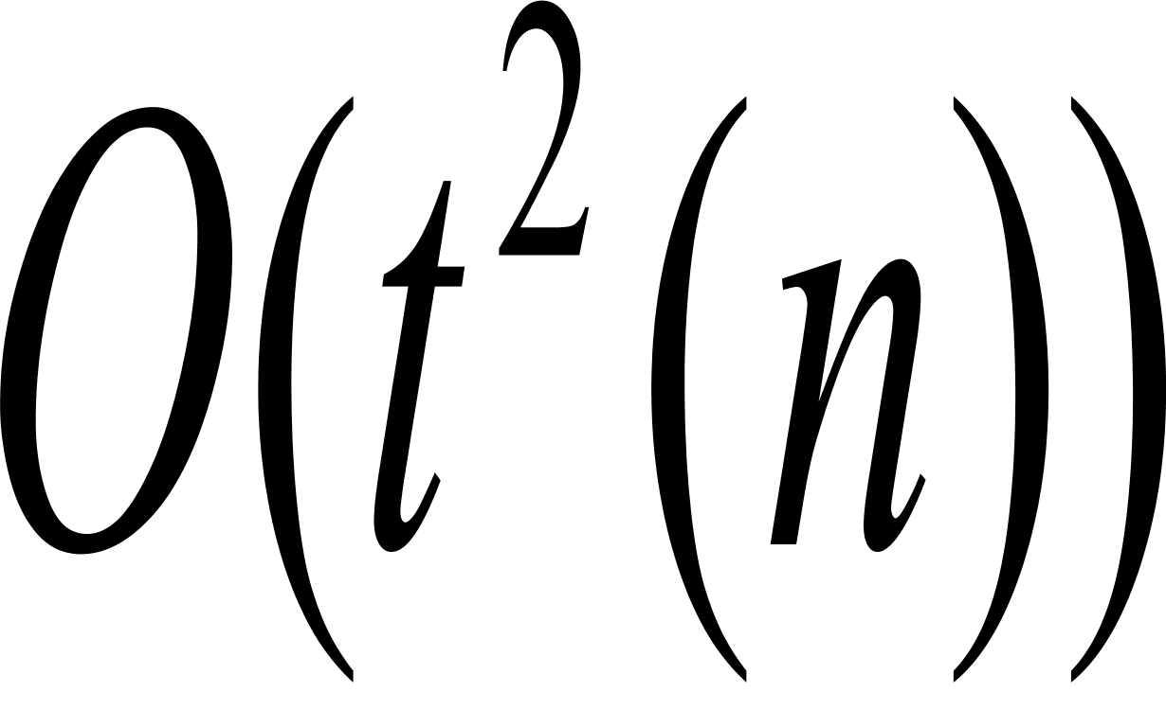
Complexity relationship among deterministic models
So the complexity of A depends on the models of computation.
Let t(n) be a function, where . Then every t(n) time multitape TM has an equivalent time single-tape TM.
Proof idea: S is a one-tape TM simulating a multitape TM M.
For each step of M, S makes two passes over its active portion of its tape: one is to obtains information for next move and the other is to carry it out. (O(t(n))
For an input w of length n, M makes O(t(n)) moves.
So the total number is O(t(n))O(t(n)) steps.

Slide 19
Simulating multitape TM by single-tape TM
1
0 1 0 1 0 u
M
a
a a a u
b
b a u
S
#
# 0 1 0 1 0 # a a a # b a # u

Slide 20
Running time of a nondeterministic TM
Let N be a nondeterministic TM that is a decider. The running time of N is the function f: N ->N, where f(n) is the maximum number of the steps that N uses on any branch of its computation on any input of length n.
This type of time complexity typically arise in brute-force search.

Slide 21
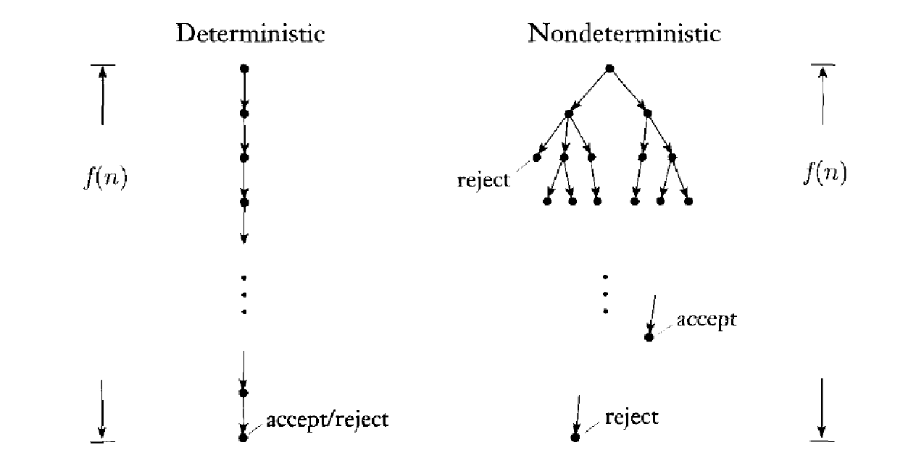
Computation tree of nondeterministic TM
nondeterminism
2
Each node is a configuration
1
2
3
1
2
3
1
……..
f(n)
reject
……..
………
accpet
reject

Slide 22
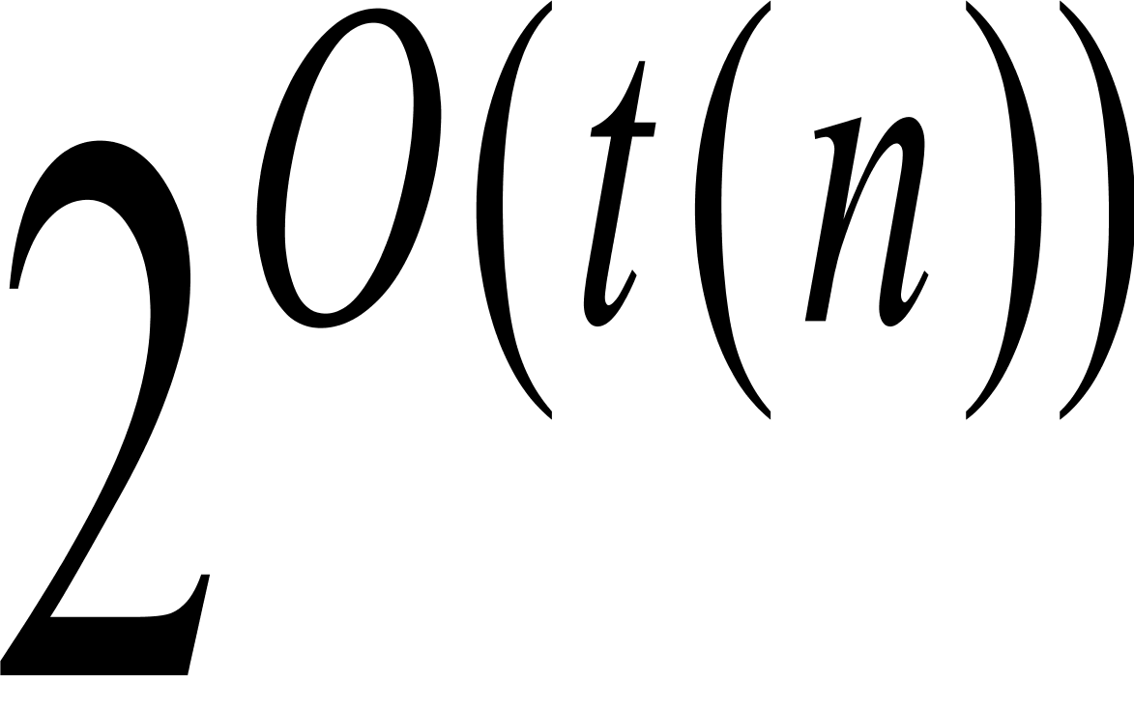
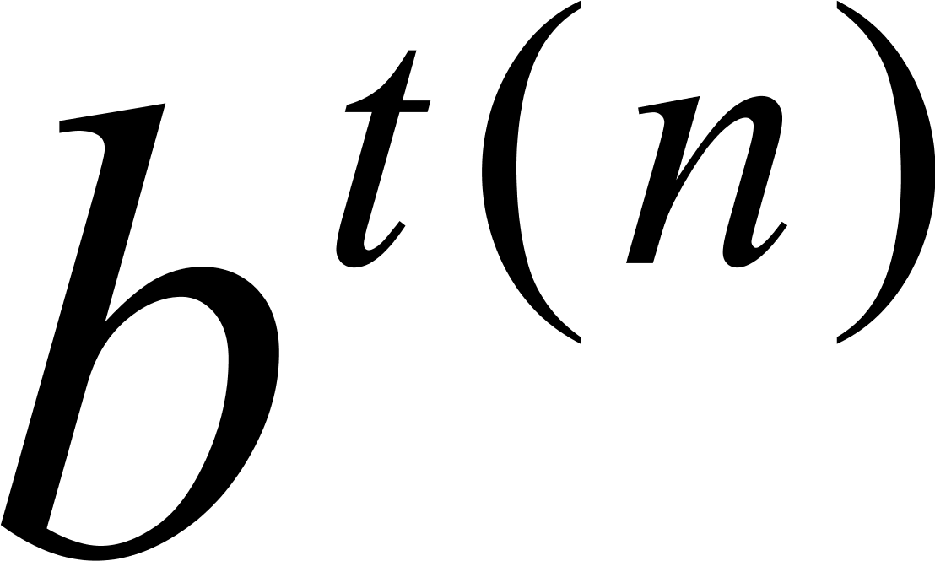
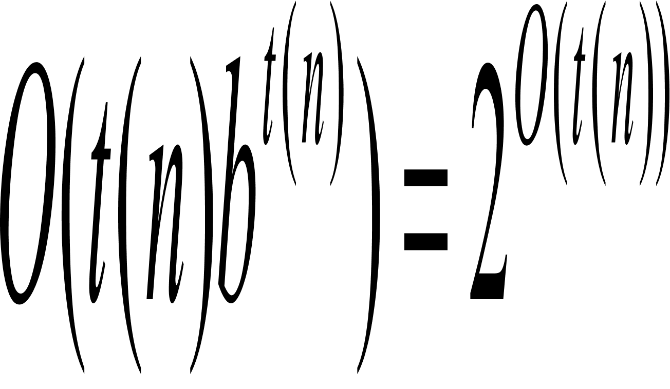
Complexity relationship between DTMs and NTMs
Let t(n) be a function, where
Then every t(n) time nondeterministic single-tape TM has an equivalent time deterministic single-tape TM.
Proof idea: Given an input w of length n,
The total number of nodes in the computation tree is bounded by
Each computation path is bounded by O(t(n)).
So the running time of the simulating one-tape DTM is
It is generally believed that this upper bound can not be improved.

Slide 23
Simulating NTM with DTM
0
Input tape
0 0 1 0 u
Never altered
D
x
Simulation tape
X x # 0 1 x u
Simulate one branch of computation
1
1 2 3 3 2 3 1 2 1 1 3 u
Address tape
Update according to the lexicographical order

Slide 24
Polynomially equivalent
Polynomially equivalent: any one of them can simulate another with only a polynomial increase in running time.
All reasonable deterministic computational models are polynomially equivalent.
The aim is to present the fundamental properties of computation, rather than properties of models of computation.
A problem can solved in polynomial time on a typical computer iff it can be solved in polynomial time by a deterministic TM.

Slide 25
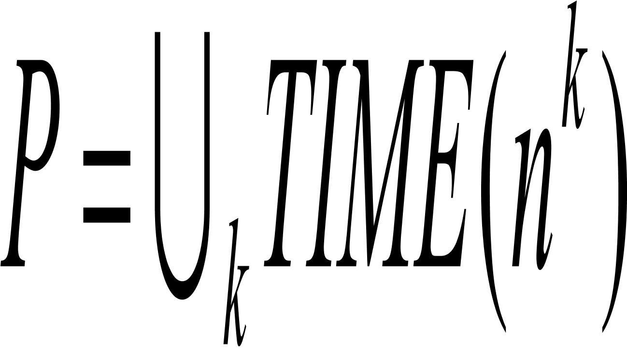
The class P: defining “efficient algorithm”
Time complexity class TIME(t(n))={L:L is a language decided by an O(t(n)) time TM}
P is the class of languages that are decidable in polynomial time on a deterministic single-tape TM. In other words,
Our strategies so far are
Reasonable representation of input
Deterministic models of computation
Asymptotic analysis
P roughly corresponds to the class of problems that are realistically solvable on a computer.
P in complexity theory is similar to decidability in computability theory

Slide 26
Extension of Church-Turing thesis
=
Intuitive notion
of algorithm
Turing machine
algorithm
Polynomial by a
realistic computer
Polynomial by
a one tape DTM
=

Slide 27
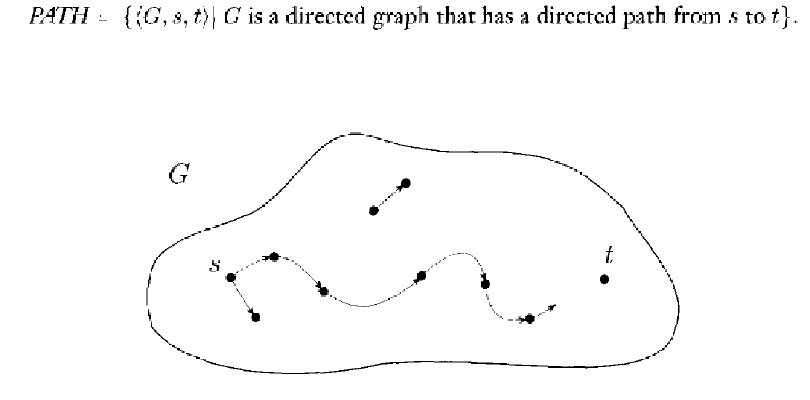
Example 1: PATH

Slide 28
Path is in P
The brute-force search is inefficient.
Proof idea:
M:=“On input <G, s,t>
1. Place a mark on node s.
2. Repeat the following until no additional nodes are marked.
3. Scan all the edges of G. If an edge (a,b) is found going from a marked a to an unmarked b, mark b.
4. If t is marked, accept. Otherwise, reject.”

Slide 29
Example 2
Let RELPRIME={<x,y>: x and y are relatively prime}.
RELPRIME is in P.
The brute-force search algorithm is inefficient.
Proof idea: The Euclidean algorithm runs as follows:
E=“On input <x,y>, where x and y are natural numbers in binary:
1. Repeat until y=0.
2. Assign x<- x mod y.
3. Exchange x and y.
4. Output x.”

Slide 30
Acceptance problem for CFG
The acceptance problem for CFG is decidable, i.e. ACFG={<G, w>:G is a CFG that generates w} is a decidable language.
Proof idea: Construct a TM S
S=“On input <G, w> where G is a CFG and w is a string:
1. Convert it into a Chomsky normal form.
2. List all derivations with 2n-1 steps, where n is the length of w.
3. If any of these derivations generate w, accept; otherwise, reject.”
Small model theorem: If G is a CFG in Chomsky normal form, then,
for any string w in L(G) of length n, exactly 2n-1 steps are required
for any derivation of w

Slide 31
Example: Every CFL is in P
Every CFL is in P.
The brute search algorithm is inefficient.
Proof idea: Use dynamic programming. On the input w=w1w2…wn
Consider the subproblems of determining whether each variable in G generates each substring of w.
The algorithm enters the solution to this subproblem in an n times n table. The (i,j)-entry of the table contains the collection of variables that generates the substring wi…wj.
First it fills in the entries for the substrings of length 1, then those of length 2, and so on.
If S is in table(1,n), accept; otherwise, reject.
Analyze the correctness and complexity of the algorithm

Slide 32

Algorithm for CFL
D=“On input w=w1…wn:
If w= and S-> is a rule, accept.
For i=1 to n,
For each variable A,
Test whether A->b is rule, where b=wi.
If so, place A in table(i,i).
For l=2 to n-l+1,
For i=1 to n-l+1,
Let j=i+l-1,
For k=I to j-1,
For each rule A->BC,
If table(I,k) contains B and table (k+1, j) contains C, put A in table（i,j).
If S is in table(1,n), accept. Otherwise, reject.
What is the time complexity by a one tape deterministic TM.

Slide 33
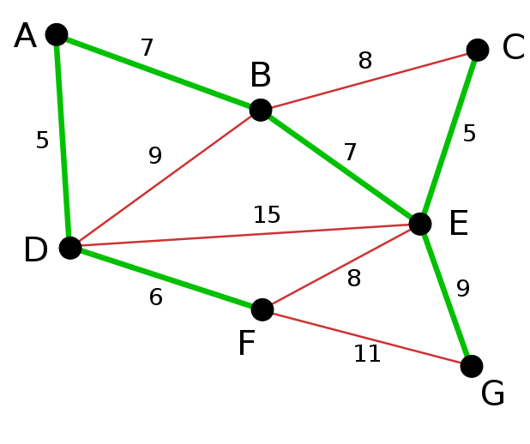
Another example of P: greedy algorithm
Kruskal Algorithm (Minimal spanning tree problem)

Slide 34
Where are we now?
PCP
A_{TM}
Brute-force search
PATH
REGULAR (o(nlogn))
CFL (O(n^3))
Dynamic Programming
Greedy algorithm
decidable
EQPDA
inefficient
HALTTM
efficient

